Slide 1

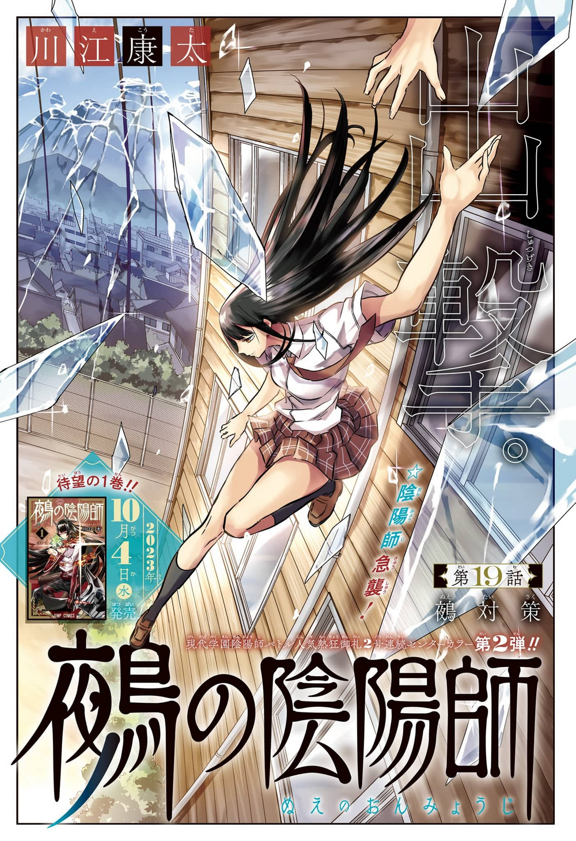

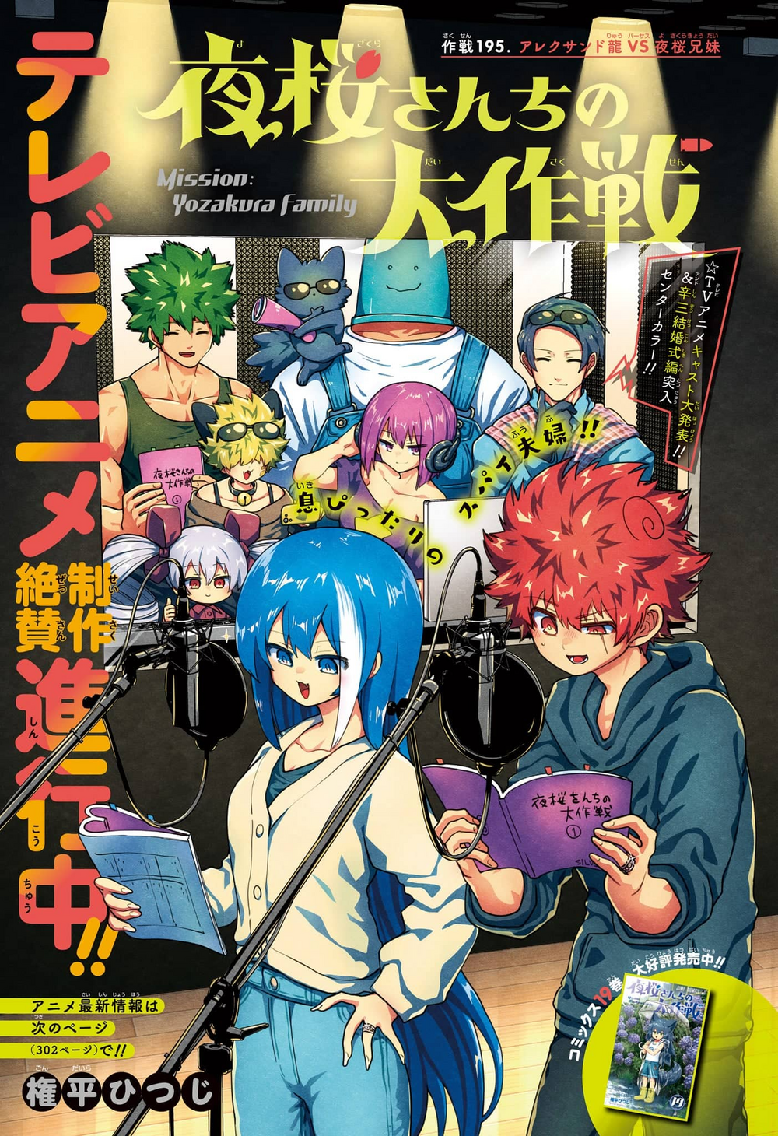

#43
#43
#43
#43
#43
#43
#43

Slide 2
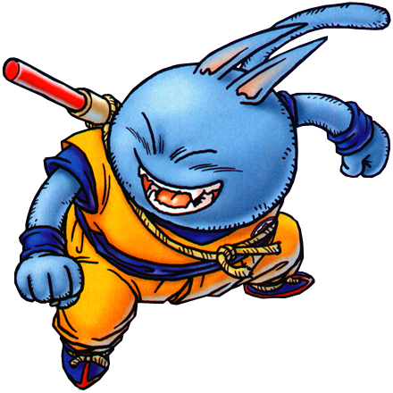

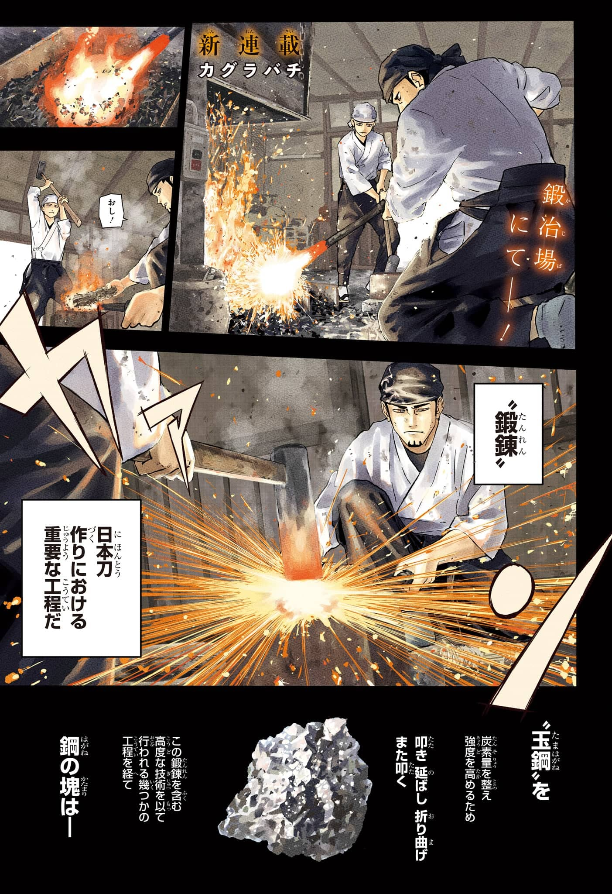

Slide 3
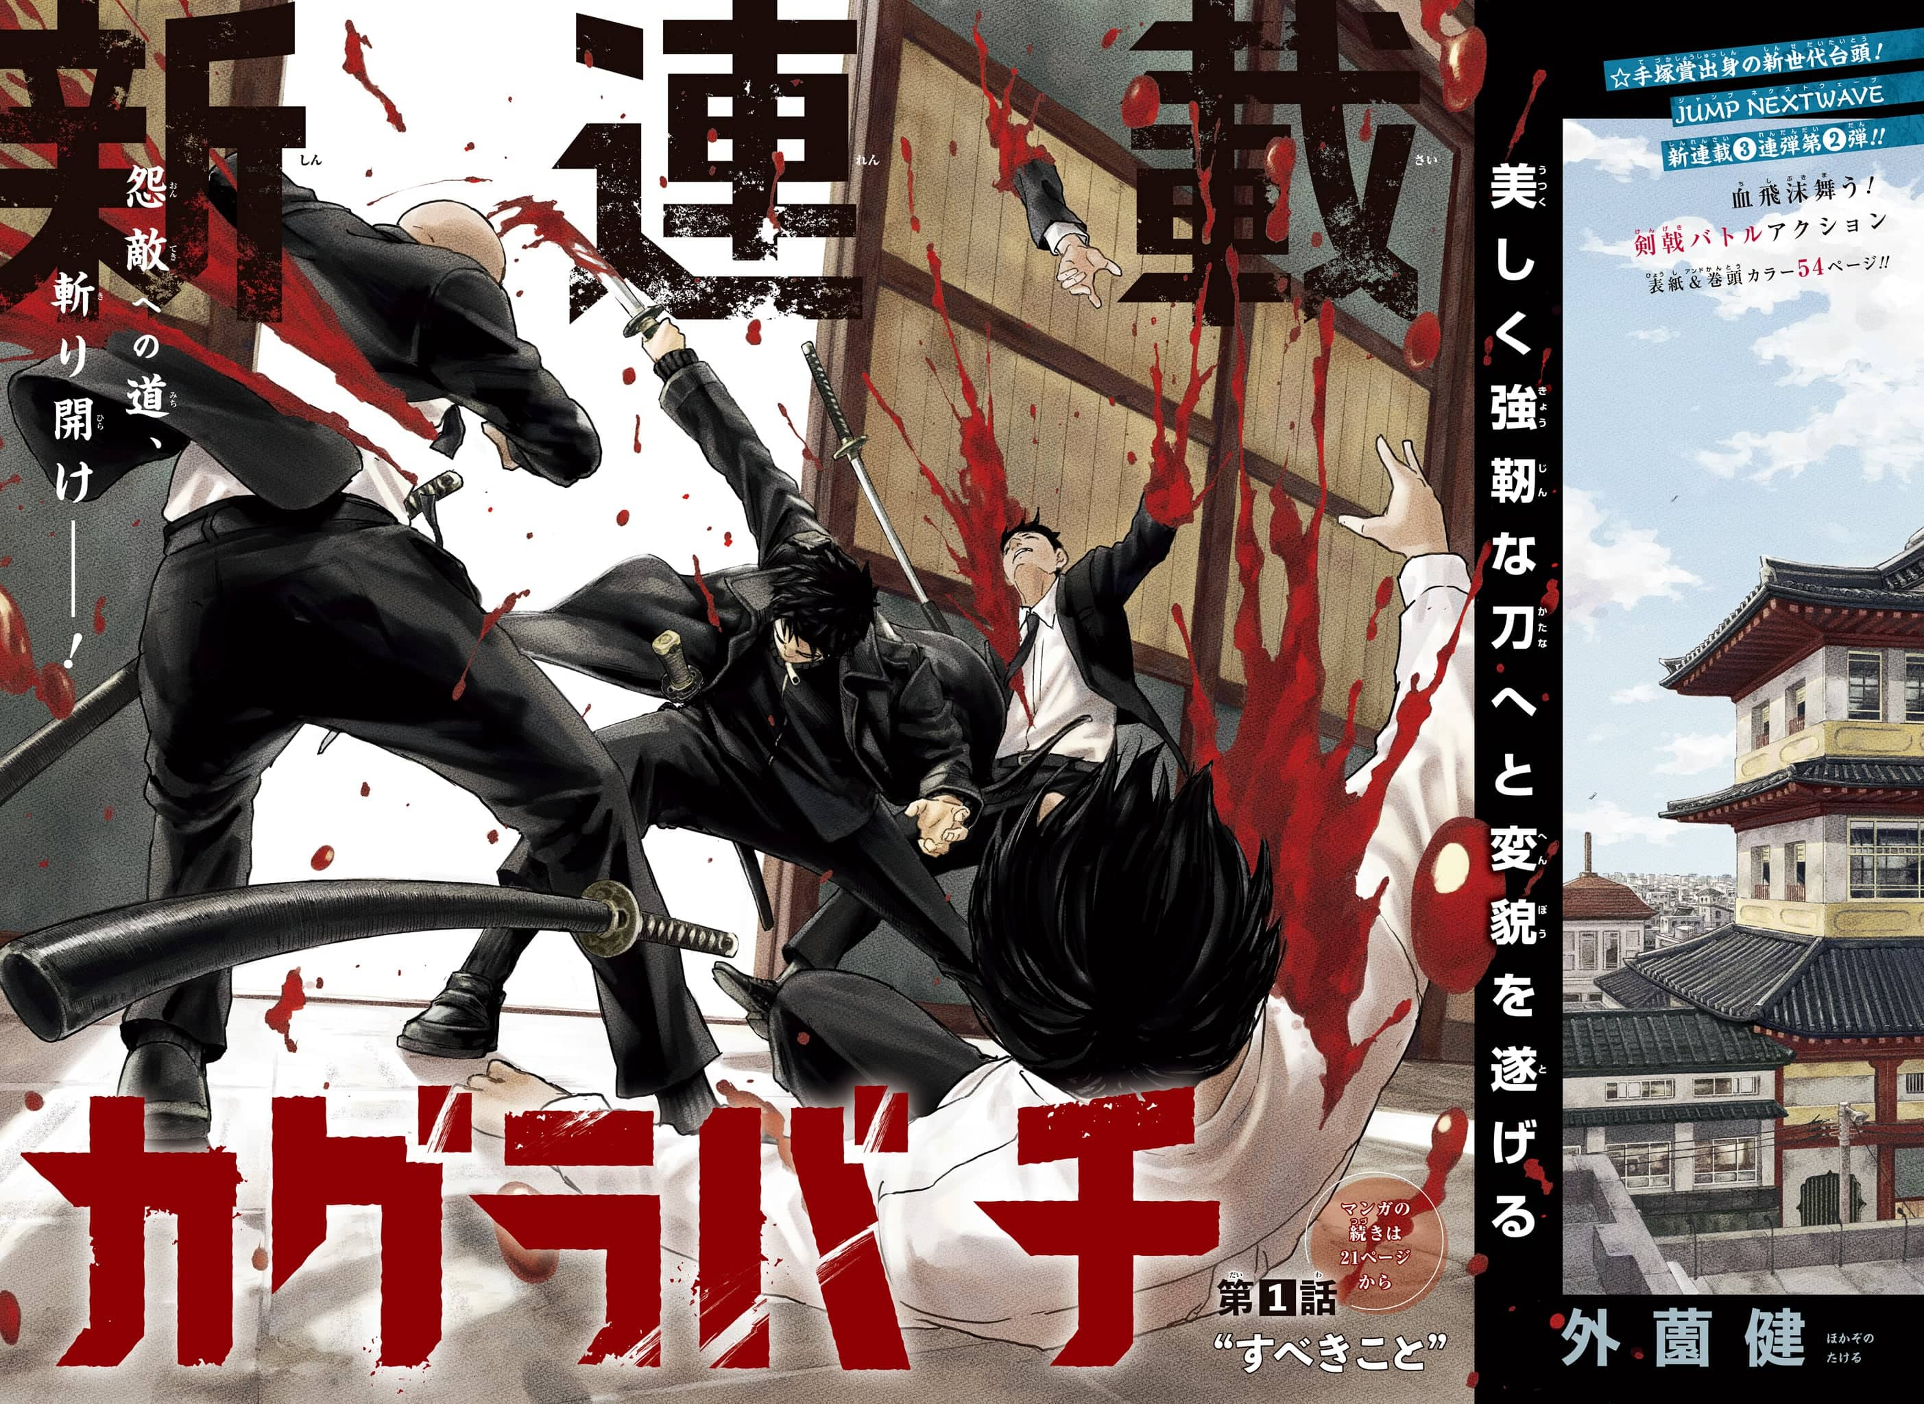

Slide 4



-3
SAKAMOTO DAYS (#143)

Slide 5
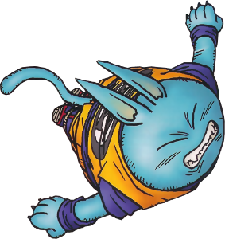
-3
SAKAMOTO DAYS (#143)

Slide 6
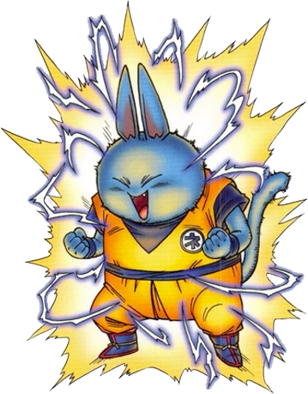
-3
SAKAMOTO DAYS (#143)

Slide 7
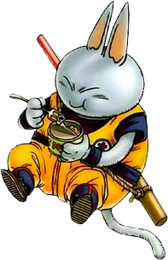
+1
SAKAMOTO DAYS (#143)

